Slide 1
Group-6
Shojib Talukder - 011201345 (Test in Burp Suit)
Samman Tasnim - 011201107 (Test in JMeter)
Md. Masum Khondhoker Efaz - 011201108 (Test in Cypress)
Fuad Hasan - 011201110 (Test in Selenium)

Slide 2


Selected System: Art Patio
Selected Tool: Selenium WebDriver
ArtPatio is a feature-rich website designed for art enthusiasts.
Features which are tested:
Buy art
Sell art
Digital art gallery
Bid for art
Follow the artist and art gallery
Vote for art
Cross-Browser Testing
Open Source and Active Community
Support for Multiple Programming Languages
Presented By: Fuad Hasan

Slide 3
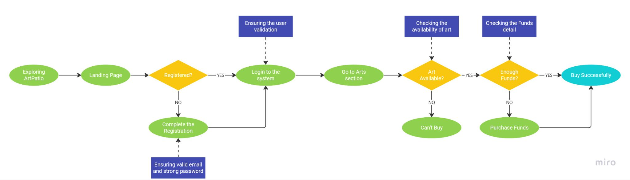
Test for Buying Arts
Presented By: Fuad Hasan

Slide 4
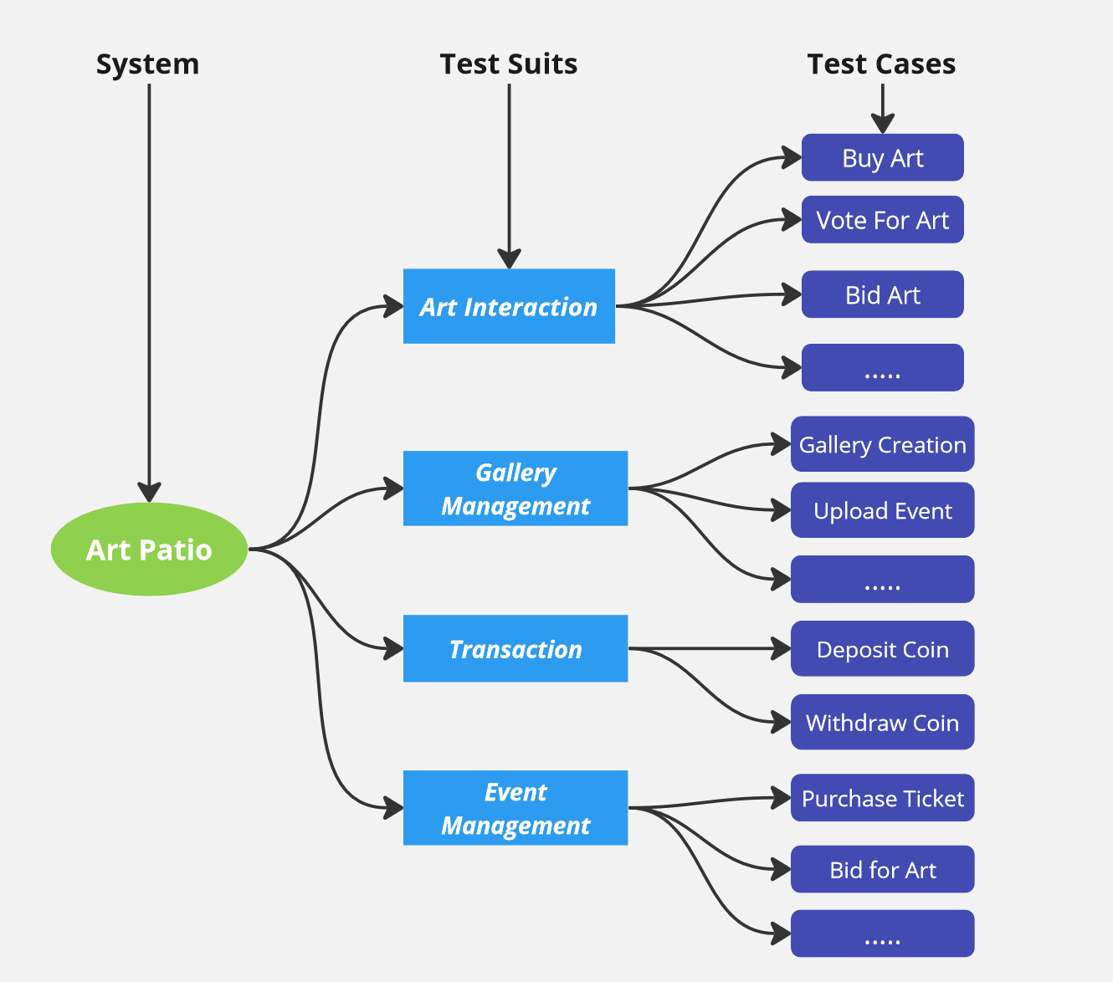
Test Structure
Presented By: Fuad Hasan

Slide 5

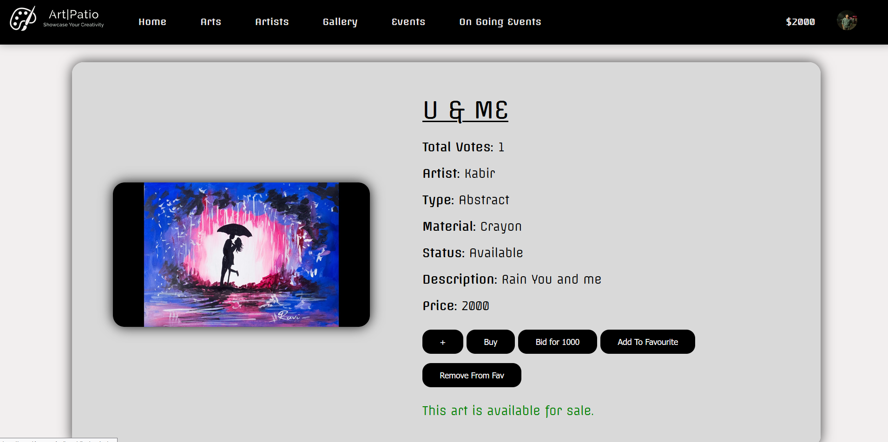
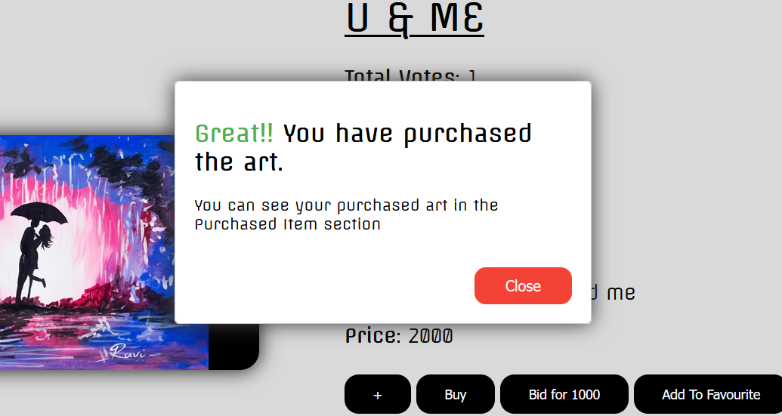
Pre Condition of Buying Arts
Buy Successful
Presented By: Fuad Hasan

Slide 6

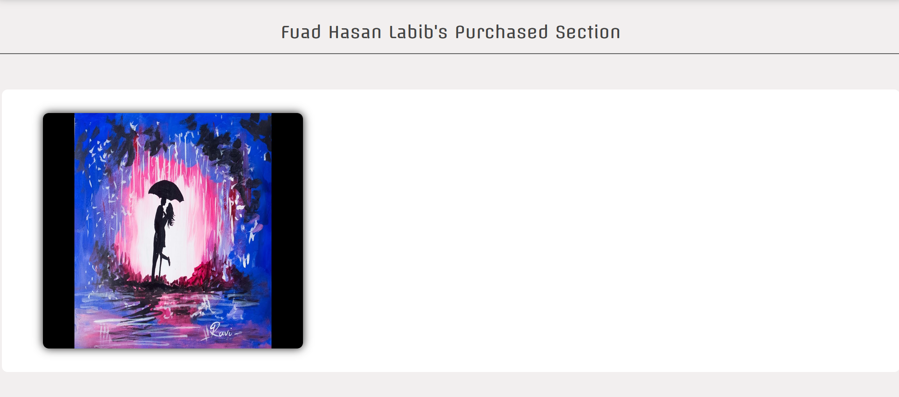
Post Condition
Presented By: Fuad Hasan

Slide 7
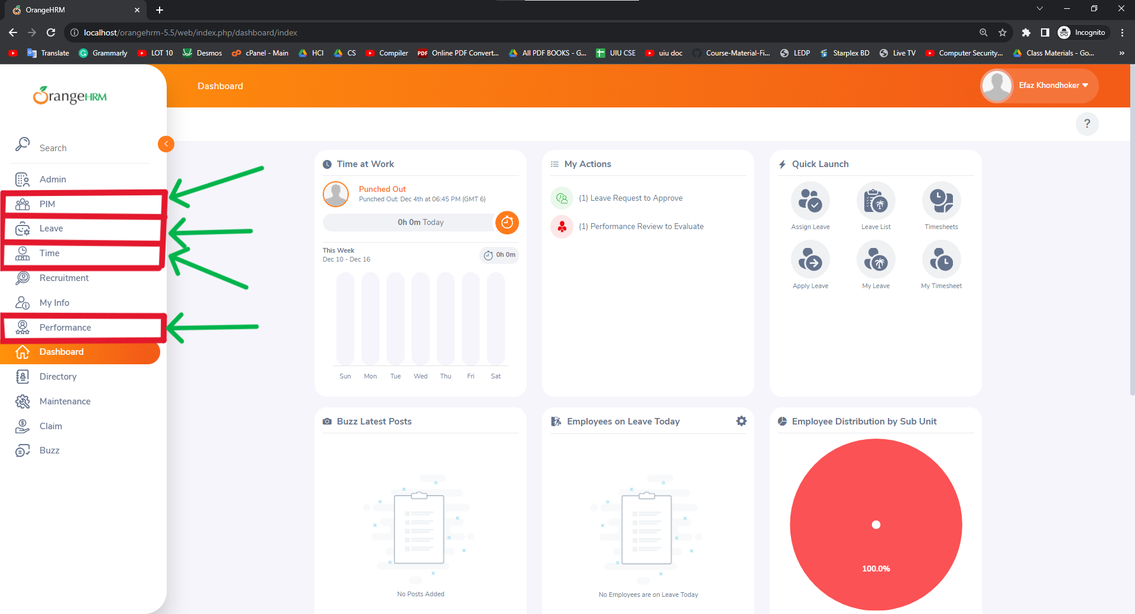
Cypress Testing
Cypress is a powerful and easy-to-use testing framework for end-to-end testing.
Feature Lists
Employee add/terminate
Regular
Irregular
Leave application
Regular
Irregular
Attendance report
Regular
Irregular
Performance
Regular
Irregular

Slide 8
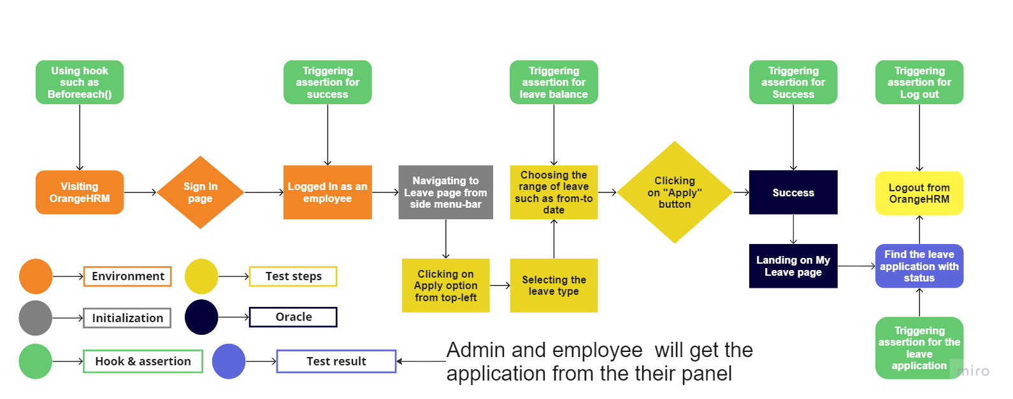
Leave Application

Slide 9
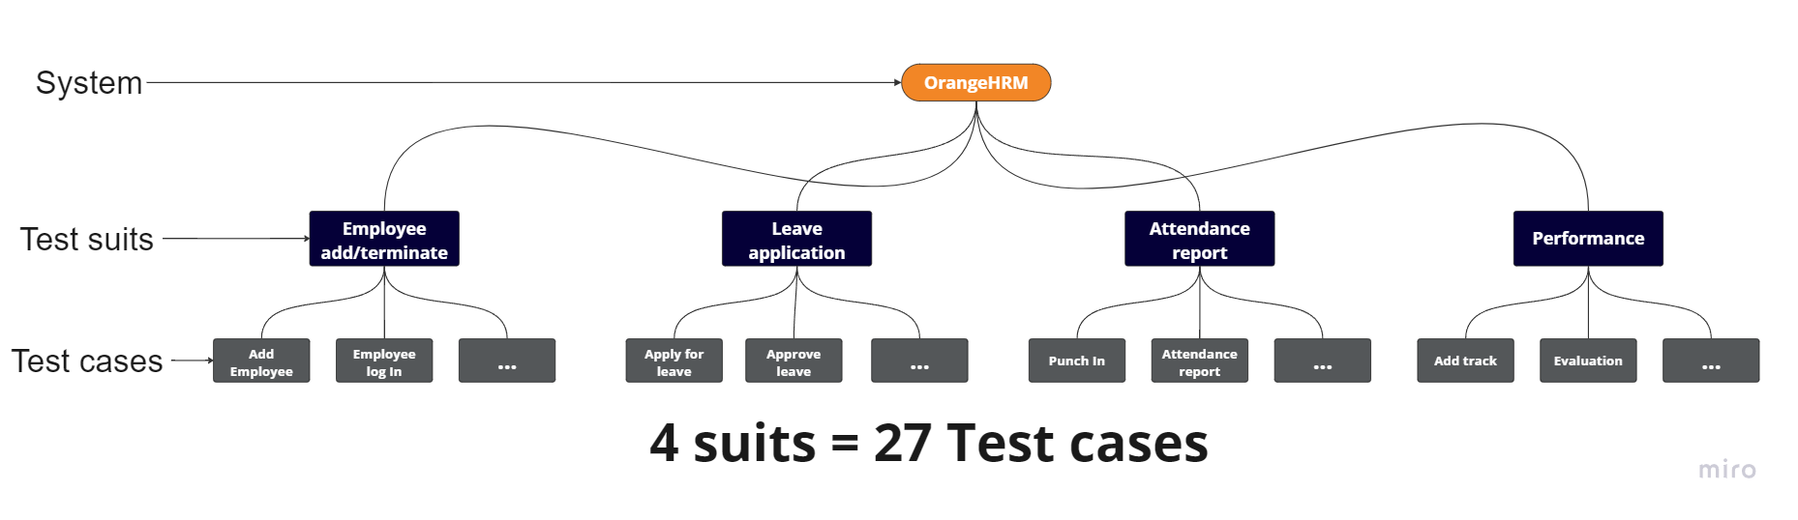
Test Structure

Slide 10
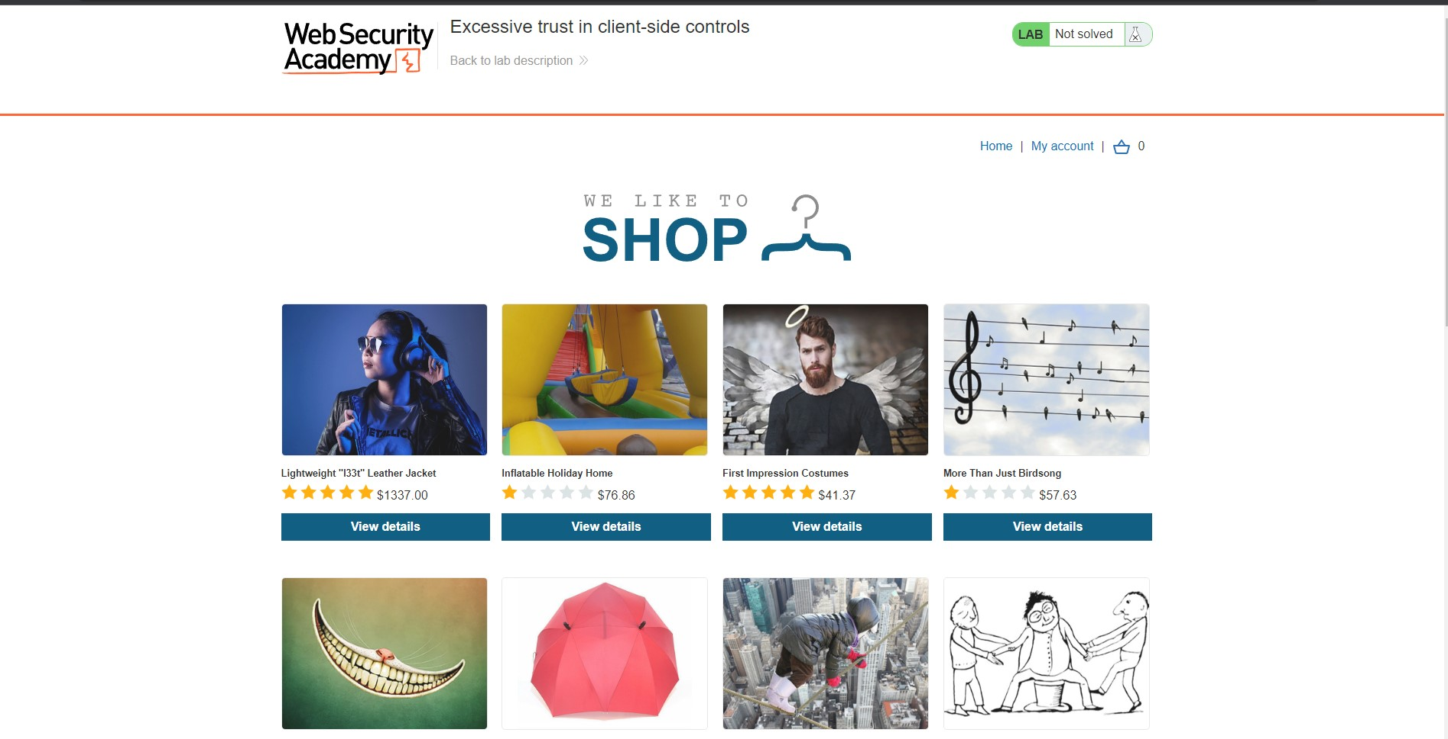
Burp Suite
Burp Suite is a leading web application security testing tool.
Feature Lists
Proxy
Intercept a Request
Modifying the HTTP Request
Set the target scope and analyze the HTTP history
Intruder
Brute Force Attack
Repeater
Reissue requests
IP Blocking
Scanner
Scan a website
Analysis the vulnerabilities
Generating a Report

Slide 11
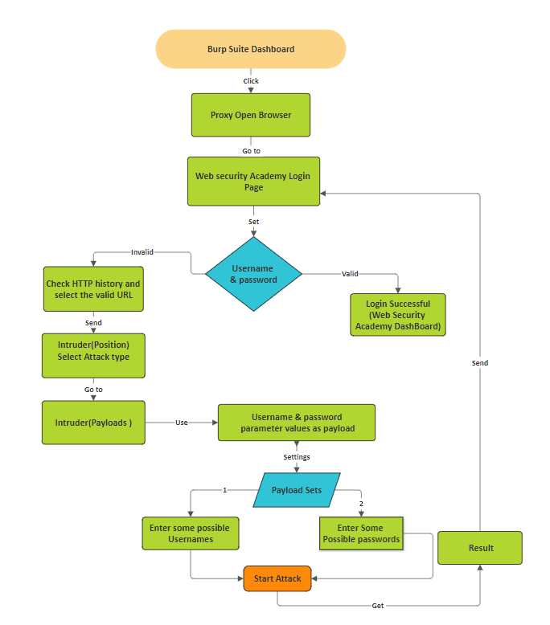
Brute Force Attack on Login Page

Slide 12
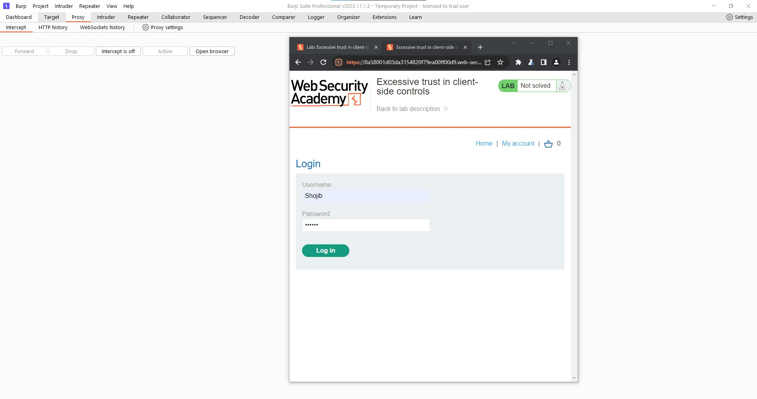
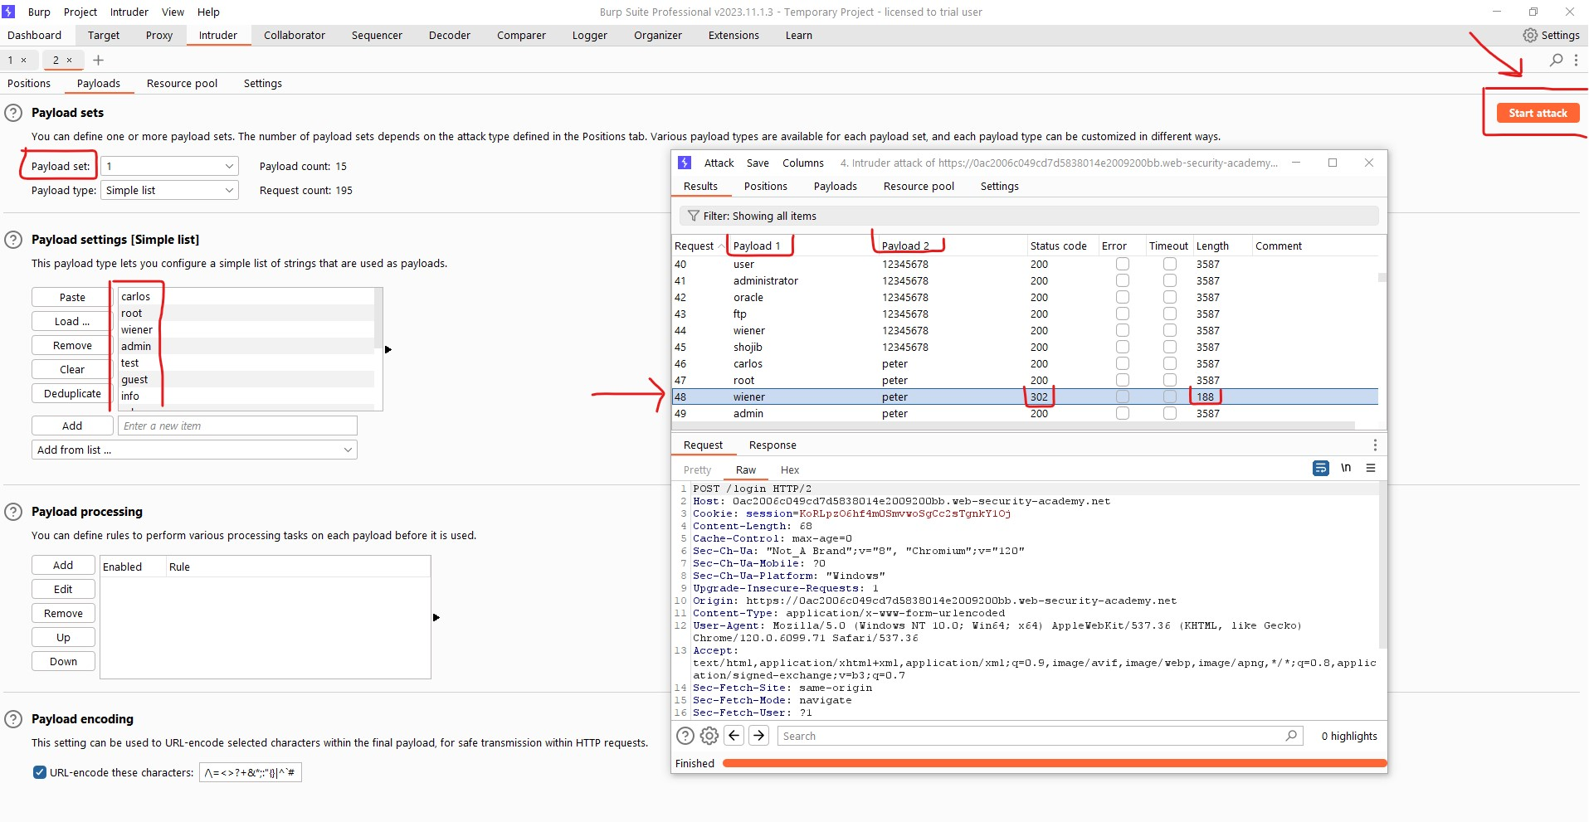
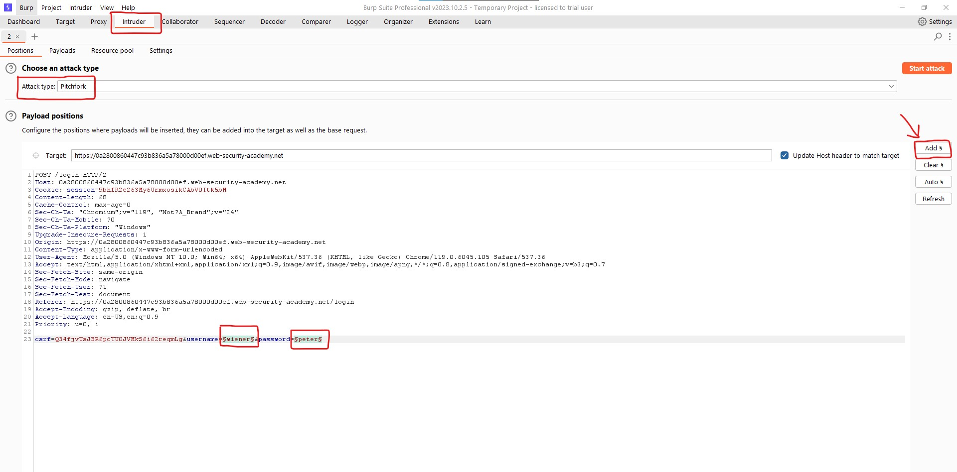
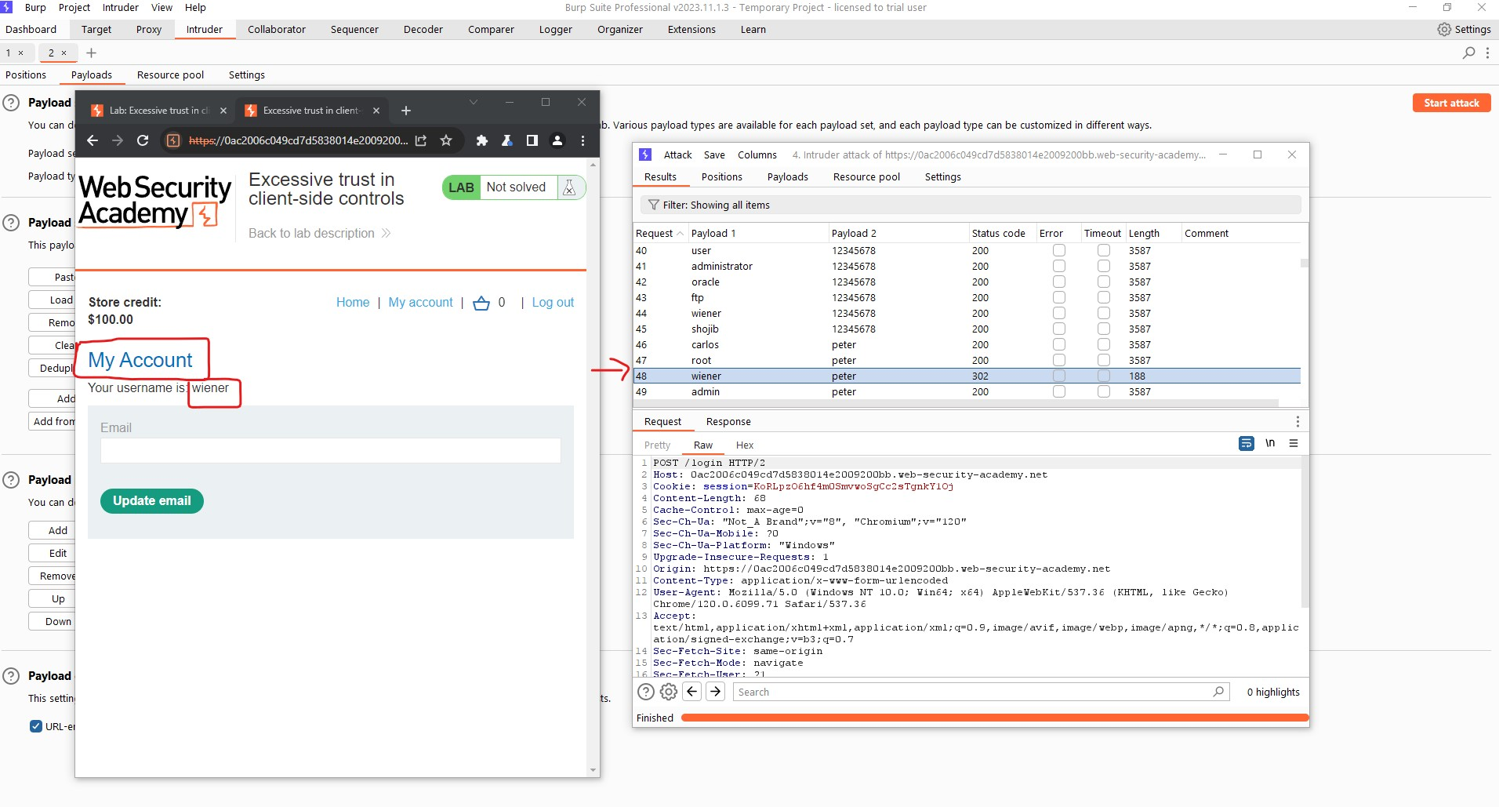
Brute Force Attack on Login Page
Step 05: Select The Attack Type
Step 1: Try to Login
Step 06: Add the payloads
Step 07: Start the Attack
Step 02 : Find the POST /login
Step 03: Right click on the POST/ Login and send to the intruder.
Step 04: Set the payload Position.
Step 08: Look for any irregular responses
Step 9 : Now Brute Force the Password

Slide 13
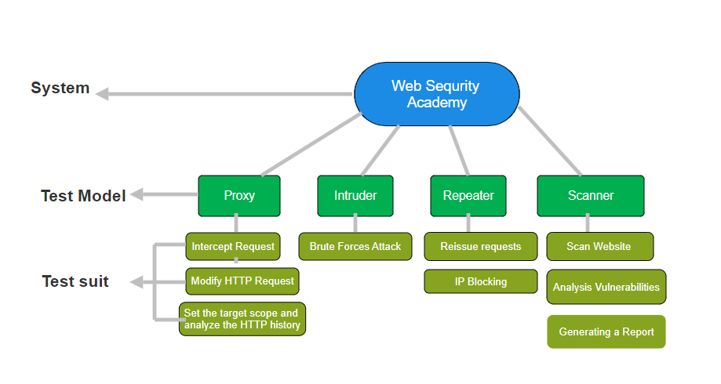
Test Structure

Slide 14
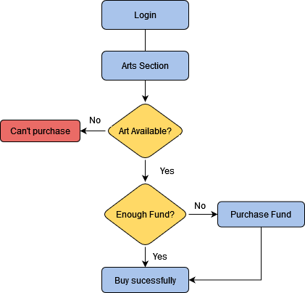

Slide 15
Test Structure

Slide 16


JMeter
Selected System: Lost and Found Information System
Selected Tool: JMeter
Web-based application that provides an online platform for individuals to post lost and found items
Feature lists which are tested
All public pages performance
HTTP Request Test
Security Test on admin login page with SQL Injection
Form Submission Test on post an item Form
Load Testing
Stress Testing
Performance Testing
Functional Testing

Slide 17
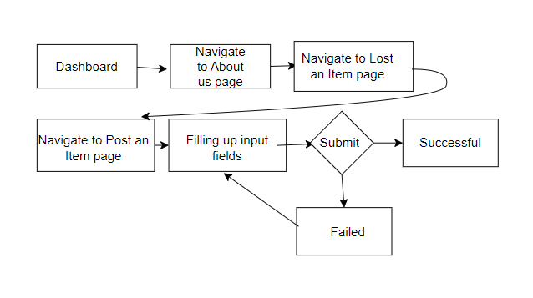
Test for multiple http requests

Slide 18
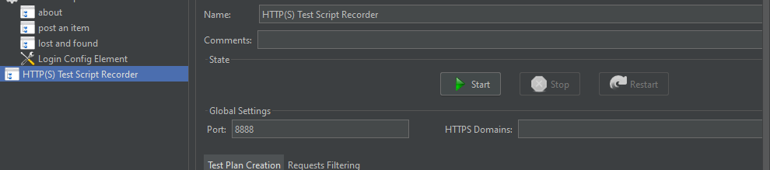
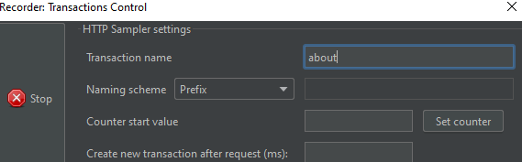
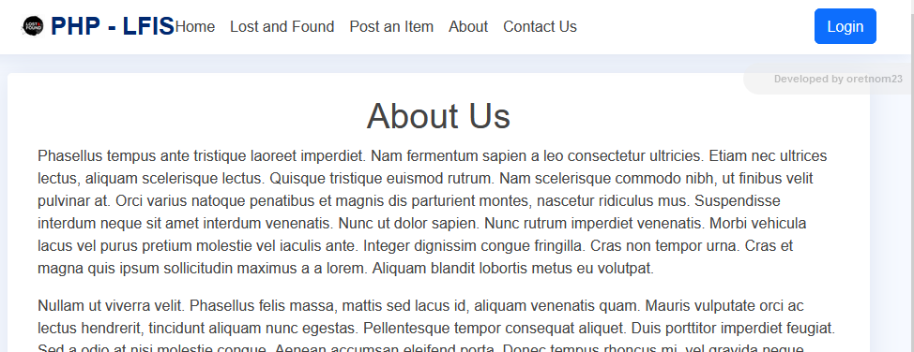
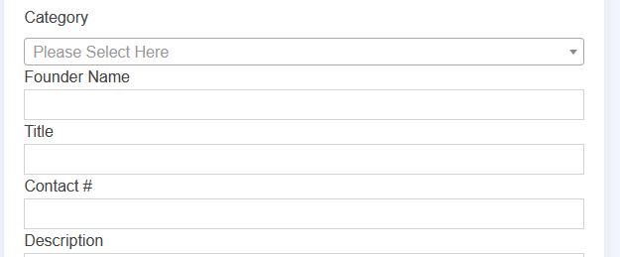


Slide 19
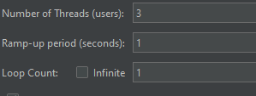
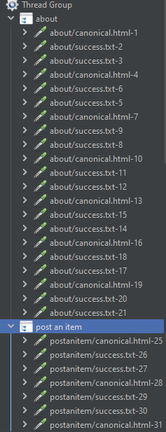
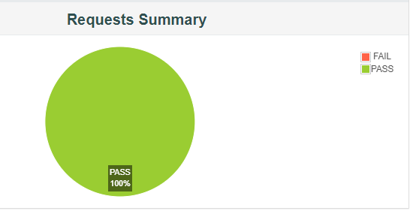

Slide 20


